Slide 1

Medical Insights Database System
A Simple Cloud-Based Healthcare Data Storage and Security Solution

Slide 2

Goals for the Medical Insights Database System
Explore possibilities and privacy issues presented to the medical community for data storage and access (HIPPA requirements)
Provide levels of authentication for users including: patients, administrative assistants, and doctors
Using Machine Learning to provide medical insights/predictions for patients to doctors to assist in diagnosing illnesses
Create a patient and doctor portal view with restricted access for easier accessibility of medical data for patients and patient data for doctors.

Slide 3
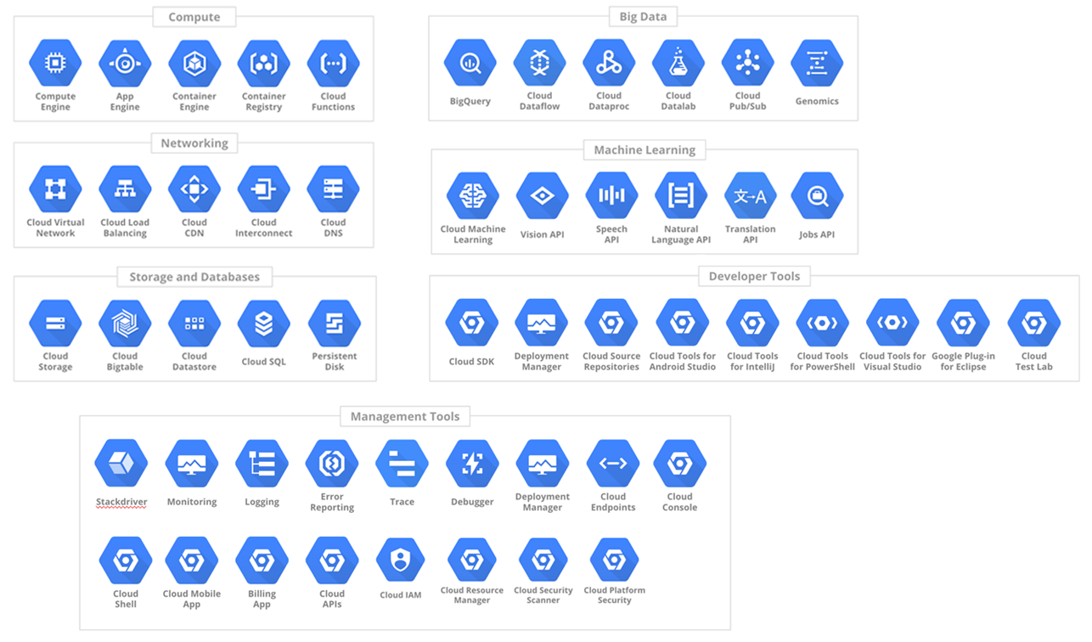
Framework: Google Cloud Platform
Why use the GCP?
Data Loss Prevention
Advanced Security Options
Flexible
Hands-on learning with what we are learning in this class

Slide 4
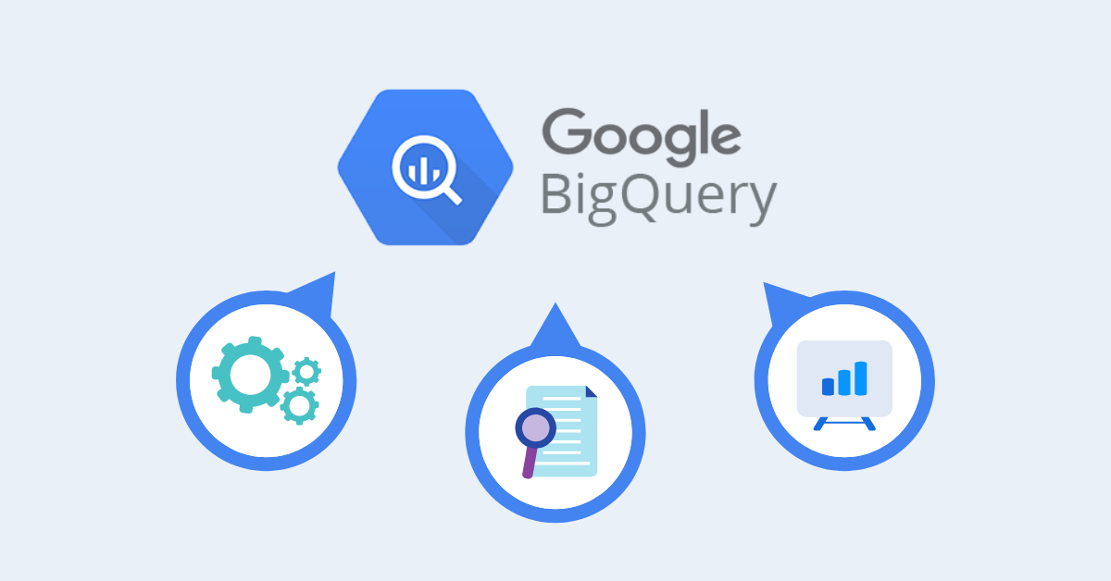
Tools: BigQuery
Query all data types with BigQuery: structured, semi-structured, and unstructured
Flexible, pay-as-you-go storage
Data visualization tools for dashboard creation to help better understand your data.

Slide 5
Confidentiality
Only users with authorized credentials can access the information.
For Example
doctors can only see their patients’ data
patients can only access their own medical data
administrative assistants can access all patients’ general information but not medical data
For Example
Data is always accessible via the patient portal
Using cloud security features, the database will be protected from outside threats
Accessibility
Confidentiality
Accessibility
System is available at all times for authorized persons. It protected from being shut down due to external or internal threats
Integrity
Data is protected from tampering and it is consistent and validated
Integrity
For Example
Medical data is prevented from tampering from patients, other doctors, or admin staff
Data is consistent across tables

Slide 6



Access Restrictions
DOCTORS
PATIENTS
ADMINISTRATION
All Patient* Medical Information
All Patient* Personal Information
Medical Insight Predictions
* patient must be under their care, and not a fellow doctor’s care
All medical data and personal information for their person
Medical Insights with the permission of the doctor in charge of their care
All patient personal information for all doctors
CANNOT ACCESS MEDICAL INFORMATION

Slide 7
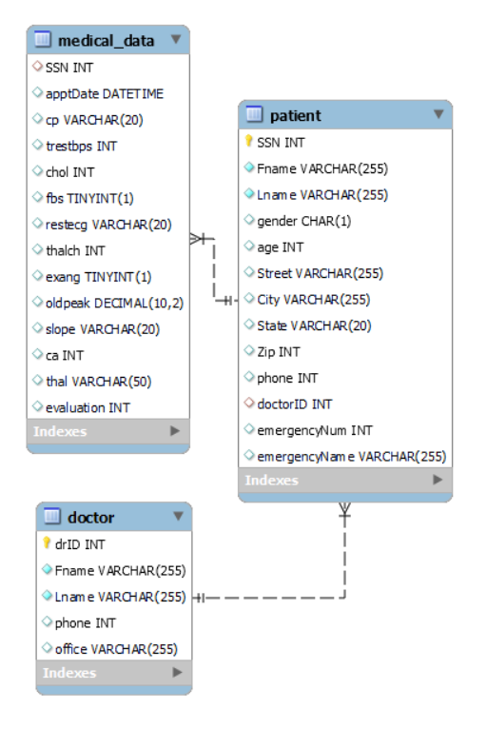
Schema
Three tables:
medical_data
patient
doctor
medical_data table and patient table are connected with patient SSN
patient table and doctor table are connected with a unique doctor ID

Slide 8


Dataset
UCI Machine Learning Repository Heart Disease Dataset
This database contains 76 attributes, but all published experiments refer to using a subset of 14 of them*
The “goal” : detect the presence of heart disease in the patient.
*we will only be using the 14 utilized data items

Slide 9

Table: Medical_Data
SSN (foreign key - references Patient)
Appointment Date: day vitals were taken
cp : chest pain type
Value 1: typical angina
Value 2: atypical angina
Value 3: non-anginal pain
Value 4: asymptomatic
trestbps: resting blood pressure
chol: serum cholesterol in mg/dl
fbs: fasting blood sugar > 120 mg/dl) (1 = true; 0 = false)
restecg: resting electrocardiographic results
thalch: maximum heart rate achieved
exang: exercise induced angina (1 = yes; 0 = no)
oldpeak: ST depression induced by exercise relative to rest
slope: the slope of the peak exercise ST segment
ca: number of major vessels (0-3) colored by fluoroscopy
thal: 3 = normal; 6 = fixed defect; 7 = reversible defect
evaluation: diagnosis of heart disease

Slide 10
Table: Patient
SSN (primary key)
First and Last Name
Gender
Age
Address
Phone Number
Email
Doctor ID
Emergency Contact Name
Emergency Contact Number
* information not supplied in the heart disease dataset with be auto-generated

Slide 11
Table: Doctor
Unique Doctor ID (primary key)
First Name
Last Name
Email
Phone Number
Office Location
* all doctor information will be artificially generated

Slide 12
Additional Table: Admin*
First Name
Last Name
Email
*table exist for access control and authentication purposes

Slide 13


Data Cleaning and Data Generation
CLEANING
The dataset requires cleaning before we can initialize the database
Fill in missing numerical values with mean values
Fill in missing categorical values with random values chosen according to the distribution of existing values
GENERATION
The dataset is limited to medical information without identifying characteristics.
To make this database security exploration more realistic, we randomly generate values to fill the personal patient and doctor information our database.
Helpful Python Packages for Generating Fake Data
names
random-address
random
faker

Slide 14
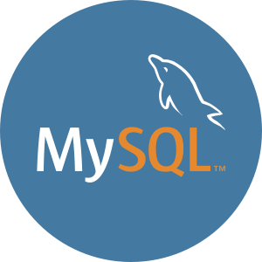
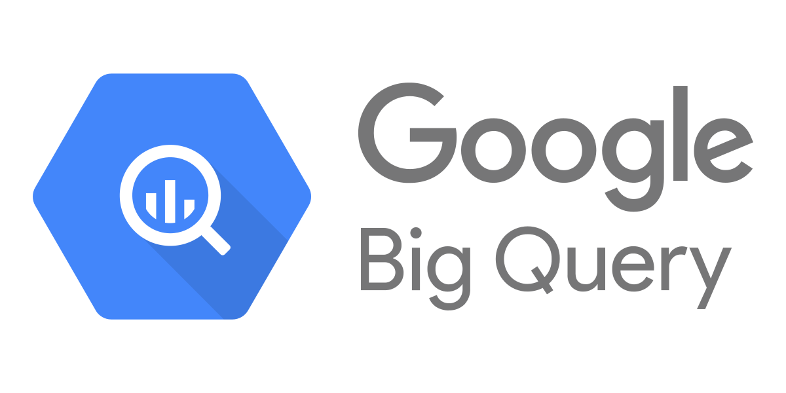
MySQL to BigQuery
Our Assumption: The cardiology department was already using MySQL to store patient data, but they are wanting to the ability to scale and have additional security methods – therefore, they want to move their data to the Google Cloud.
To achieve this, we need to set up the environment:
We set up a project and dataset configured in BigQuery
We ensure that we have a direct connection the MySql Database
We create .json service account file key to access GCP

Slide 15

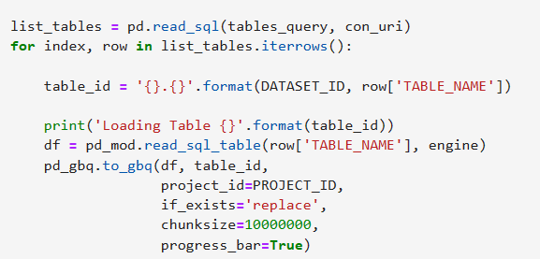
MySQL to BigQuery: Continued
Step 1: Get All Tables in the Database
Step 2: For ever table in the database:
2a. Using pandas modin, execute the read_sql_table function which acts like a select statement to fetch the full table data
2b. Load data frame to BigQuery using the pandas-gbq module

Slide 16

MySQL to BigQuery: Modules Used
Pandas: open source data analysis and manipulation tool built on top of the Python programming language
Pandas Modin: a library that allows us to run pandas computations in parallel
Pandas-GBQ module: provides a wrapper for Google’s BigQuery analytics web service to simplify retrieving results from BigQuery tables using SQL-like queries

Slide 17


Application and Data Security Development

Slide 18

The AppSheet platform allows users to create mobile apps from cloud-based databases
AppSheet's platform is verified as SOC2 compliant (privacy, security, confidentiality, processing integrity, and availability)
Provides features to meet HIPPA requirements

Slide 19

HIPAA Implementation
For users who are subject to the requirements of the Health Insurance Portability and Accountability Act (HIPAA), AppSheet supports HIPAA compliance as a business associate
Under HIPAA, certain information about a person’s health or health care services is classified as Protected Health Information (PHI)
How? AppSheet offers the ability to mark certain data in a customer's data store as sensitive, which obscures it in the audit logs

Slide 20
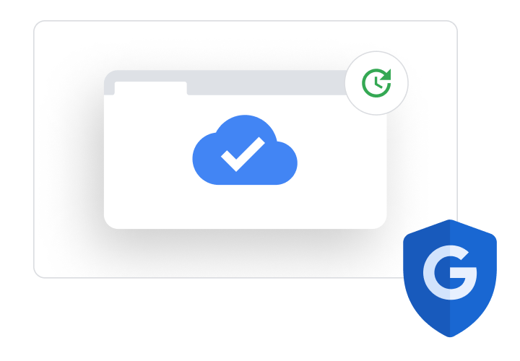
AppSheet Security: The Essentials
Authentication: Allows you to reliably identify users of your application.
Application access control: Allows you to control who can run your application.
Data access control: Allows you to control what data each user sees.
Auditing: Allows you to monitor application use.

Slide 21
Security: Authentication
Our Medical Insights App REQUIRES sign-in
Our users are authenticated with Google (since we are using it as the backend cloud-service). However, users can be authenticated with the following services:
Apple, Box, Dropbox, Google, Microsoft, Salesforce and Smartsheet
Implement restricted access: the app is shared with a restricted audience to control who can use and view the app

Slide 22
Security: Access Control
In AppSheet, there are two different ways to control access to the data:
Slices
Slices behave like tables in the UI of the app
Exclude some data for presentational purposes
Enables various views for different users
Security Filters
Table Level Conditions
Protects sensitive data as it isn’t sent to the device
Can help with performance by restricting data sent to the device

Slide 23
Security: Access Control and Security Filters
After authentication, AppSheet knows the user's email address. Therefore, you can filter the data a user receives, based on their email address.
In every table, there is a field that identifies a user. We can use this identifier to filter our results.
For Doctors, we apply security filters based on the Doctor’s ID and email. Doctors may only access patient’s information that are associated with their Dr ID
For Patients, we apply security filters based on the Patient’s email and SSN. Patients may only access their own personal data and medical appointment data.

Slide 24

AppSheet: Auditing
AppSheet provides an Audit History
Record of recent interactions occurring in the applications
It contains an entry for every:
Sync between the users of the app and the backend
Add, edit or deleting users
Add, edit, delete, action, or read using the Appsheet API
Invocation of a bot

Slide 25
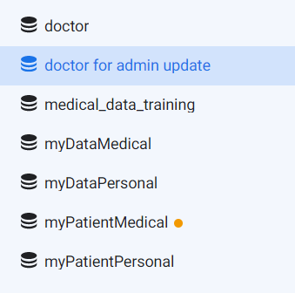
Security: Data Table Restrictions
The original BigQuery tables go directly to these new views with separate access methods.
Read only
Doctor
Read, write and update
Patient
Read only
Read and update
Read only
Medical Data
Read & write
Read only
*This is similar to creating “views” in BigQuery for access control (https://www.cloudskillsboost.google/focuses/3690?parent=catalog)

Slide 26
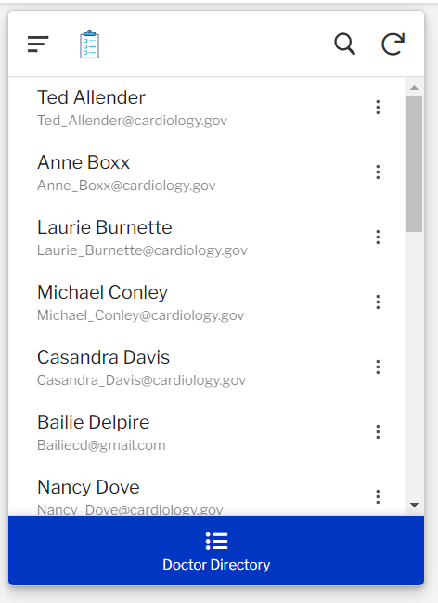
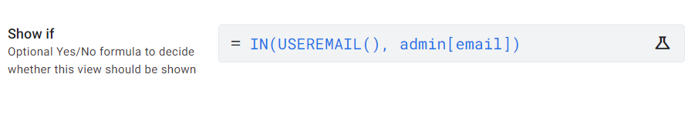
Security: Views
Different views have “security” by nature themselves. Doctors view in the app is different than patient, is different than admin, etc.
Even if someone managed to get in the app, they would ONLY see the Dr. Directory with no way of rectifying that.

Slide 27
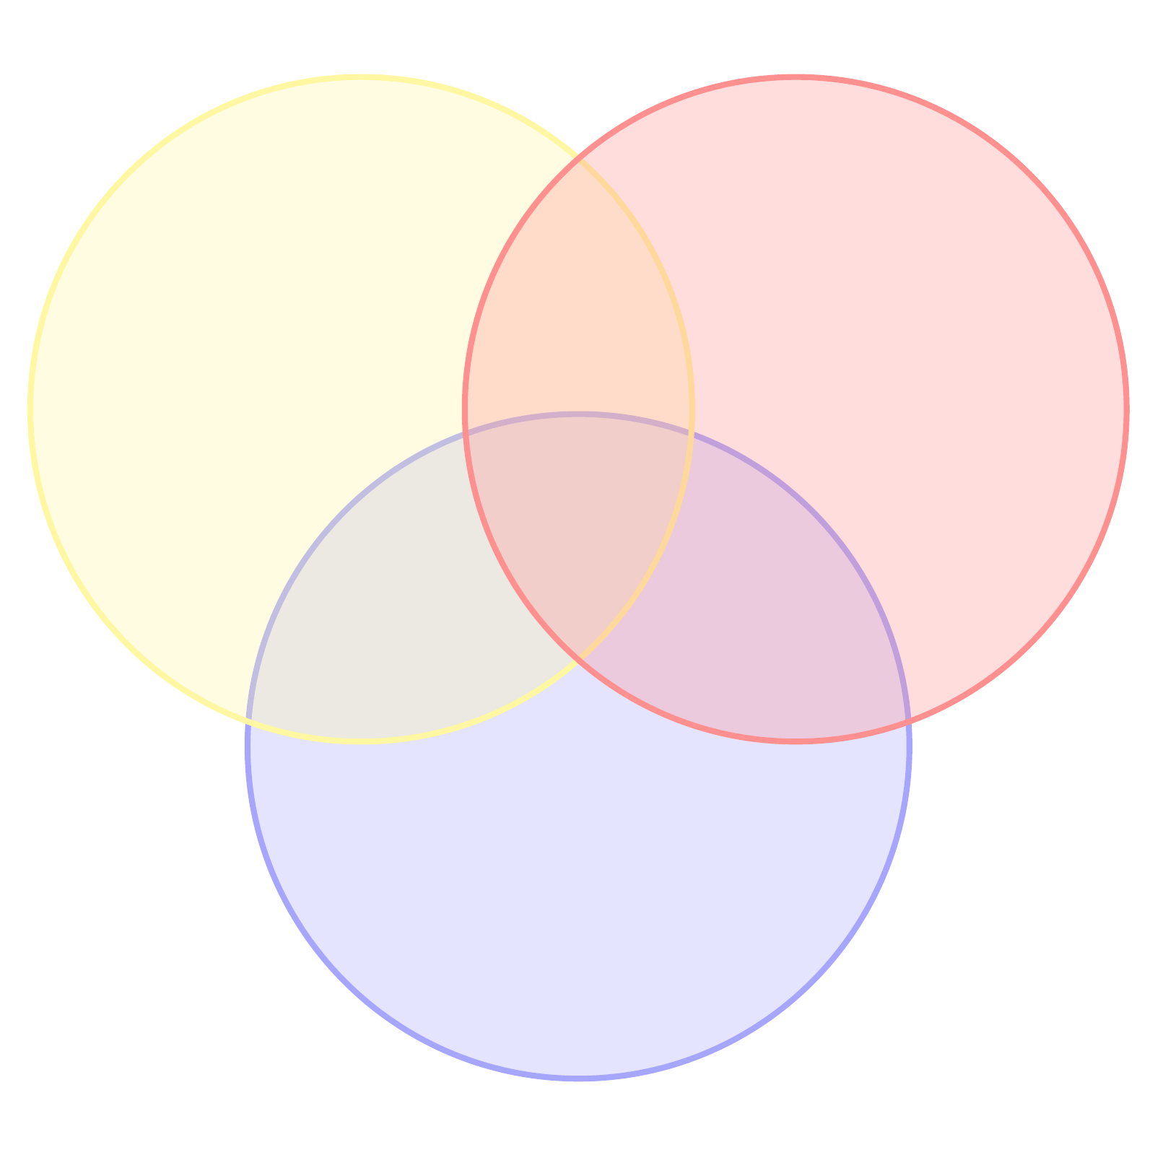
Putting it all together:
Table Permissions
Security Filters
Data
Security
View Access

Slide 28





Table
Security Filter
View
All Views
Table: doctor
Table: patient
Patient View
Table: medical_data
Table: patient
Doctor View
Table: medical_data

Slide 29
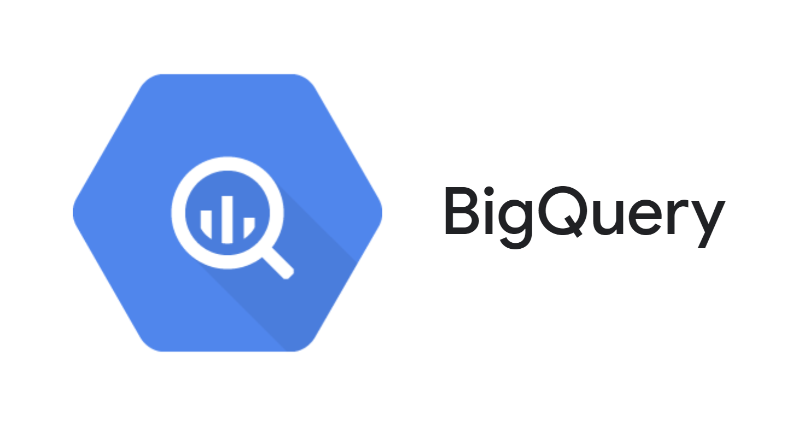
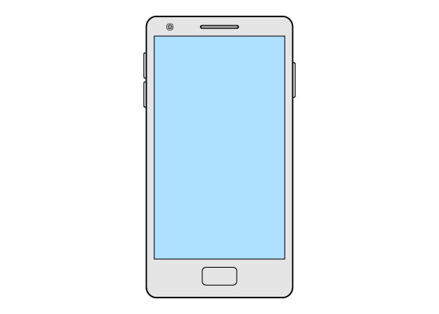
Block Diagram
View
View
Google Authorization
View
End User
View
View
Security Filters

Slide 30
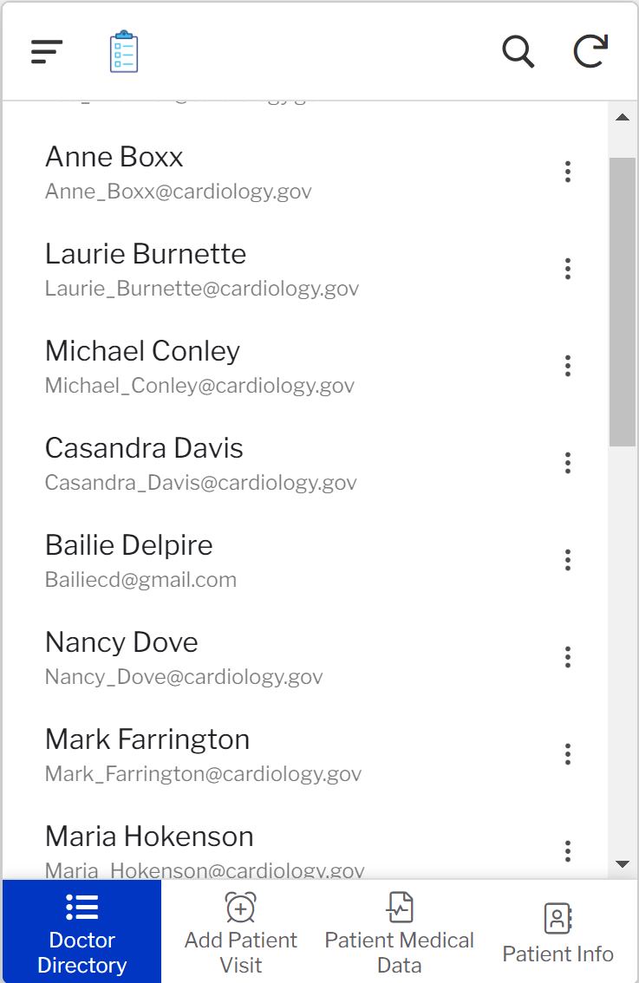
Doctor View
If an email is in the Doctor table you can:
View the Doctor Directory
Add patient visit information
View YOUR Patient medical data
View YOUR Patient personal data
[doctorID] = LOOKUP(USEREMAIL(), doctor, email, drID)

Slide 31
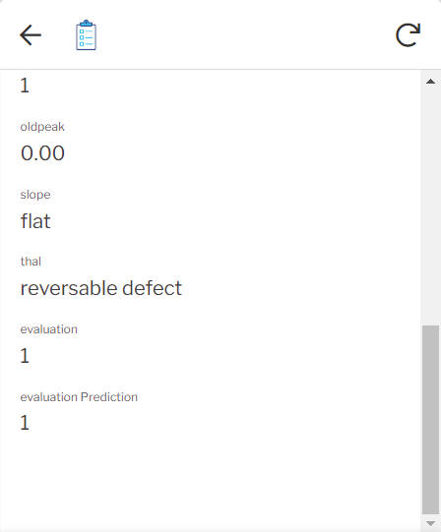
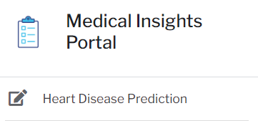
Doctor View: Heart Disease Prediction
Machine learning in AppSheet allows for us to train and deploy our predictive model easily
Doctor can view appointment data and views a heart disease prediction for the patient.

Slide 32
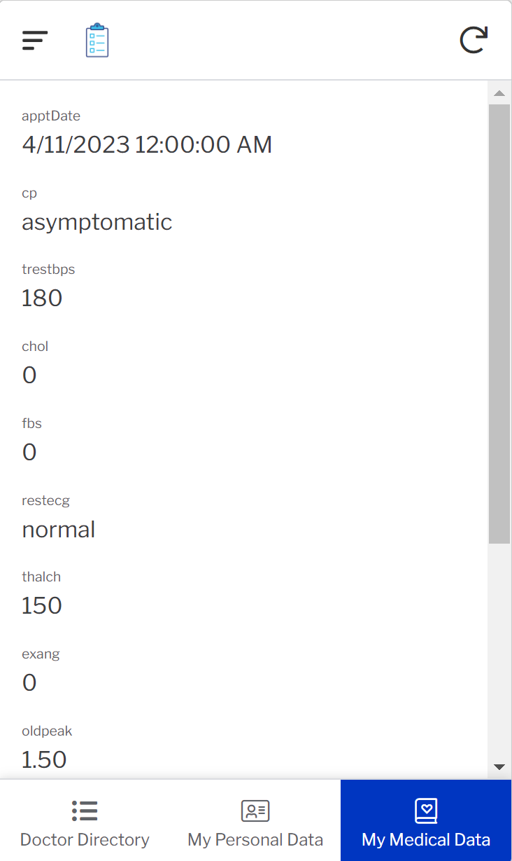
Patient View
If the users email is in the Patient table you can:
View the doctor directory
View YOUR personal data
View YOUR Medical Data
Email: IN(USEREMAIL(), myDataPersonal[email])

Slide 33
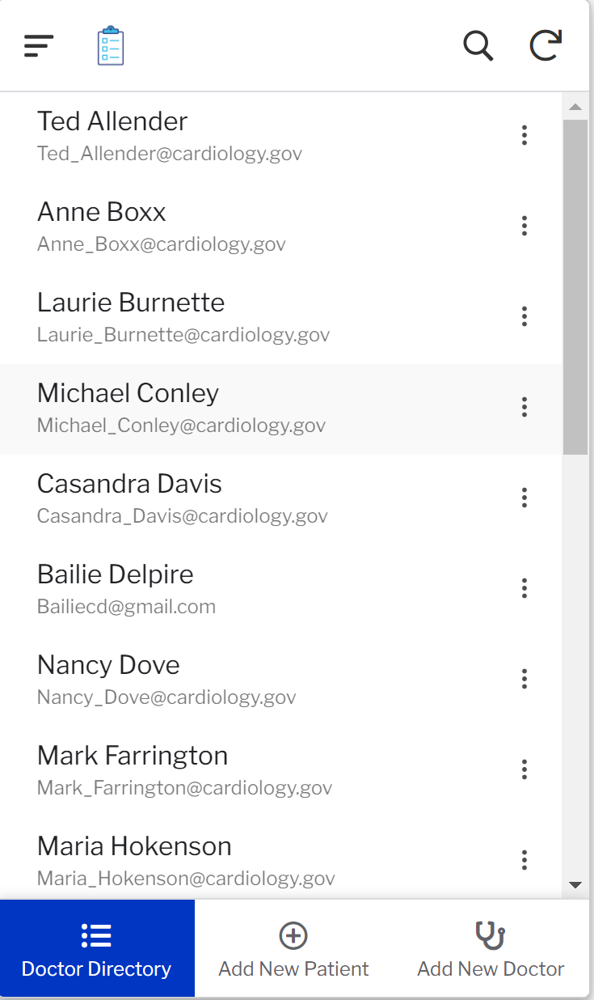
Admin View
If an Email is in the Admin Table you can:
View Doctor List
Add new Patient
Add new Doctor
If email IN(USEREMAIL(),admin[email]) this view is available.

Slide 34
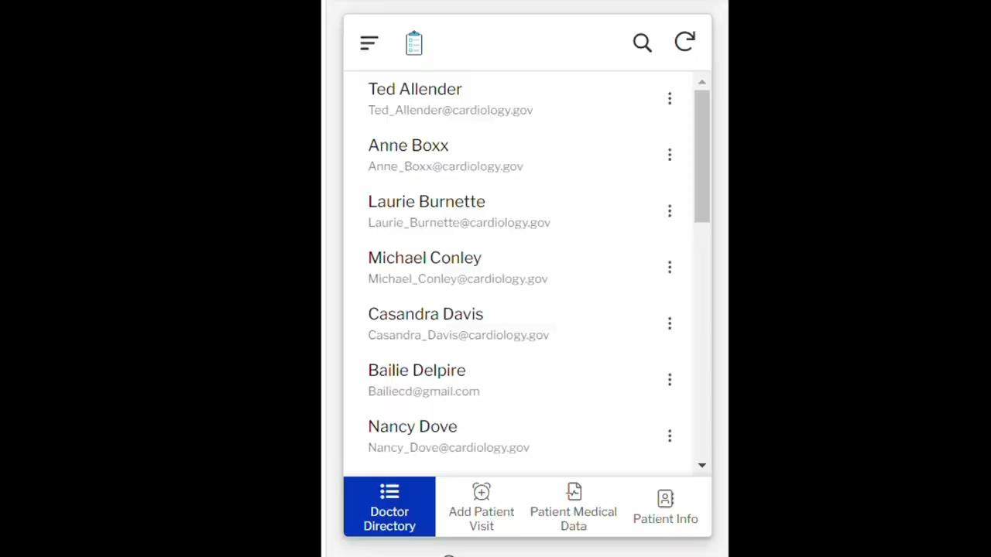

DEMO

Slide 35

Questions?

